Slide 1
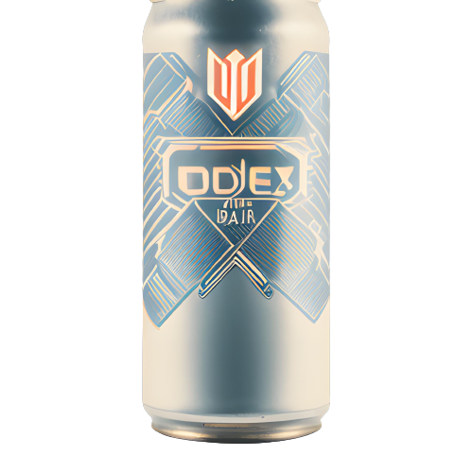
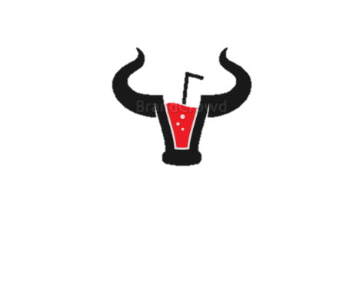
Customer Survey Report
Domain: Food & Beverages
Function: Marketing
CODEX

Slide 2

Company Overview:
CodeX is a German beverage company that is aiming to make its mark in the Indian market. A few months ago, they launched their energy drink in 10 cities in India.
Their Marketing team is responsible for increasing brand awareness, market share, and product development. They conducted a survey in those 10 cities and received results from 10k respondents.

Slide 3
Index:
Demographic Insights
Consumer Preferences
Competition Analysis
Marketing Channels and Brand Awareness
Brand Penetration
Purchase Behaviour
Product Development

Slide 4
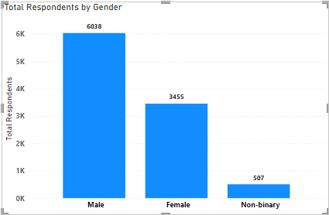
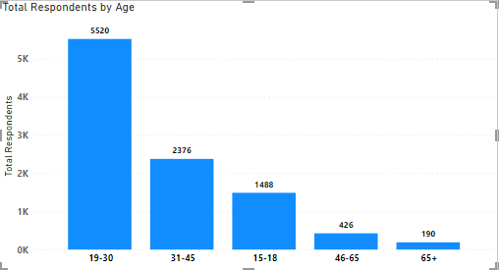
1. Demographic Insights:
Insights:
60.38% customers are Male followed by 34.55% Females and 5.07% non-binary.
Most respondents are from 19-30 years age group (55.20%).

Slide 5
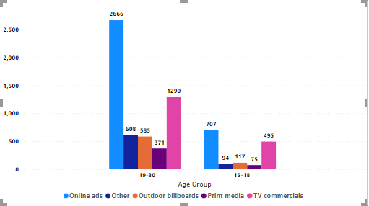
1. Demographic Insights Cont.
Insights:
Most effective medium of marketing is Online ads and then TV Comms.

Slide 6
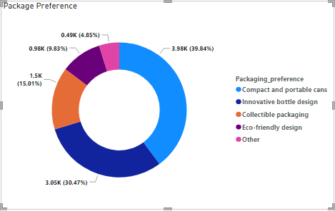
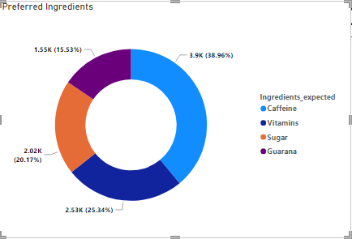
2. Consumer Preferences:
Insights:
39.84% of the respondents wants compact and portable cans.
Caffeine and vitamins are two most preferred ingredients among all.

Slide 7
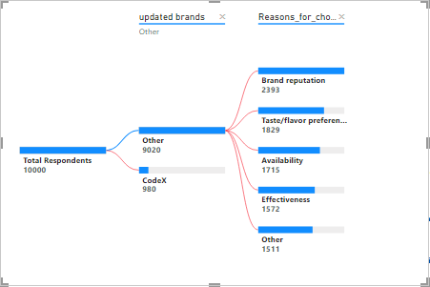
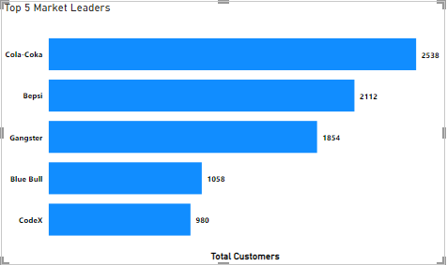
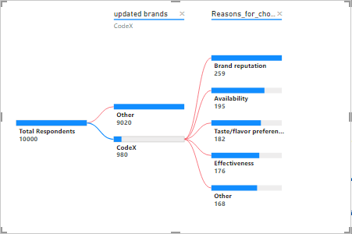
3. Competition Analysis:
Insights:
Cola coka is the current market leader with
(25.38% customers).
Main reasons for choosing other brand are
1.Brand reputation, 2.Taste/ flavor
while for choosing Codex the main reasons are
1. Brand reputation, 2. Availability and then 3. Taste/flavor

Slide 8
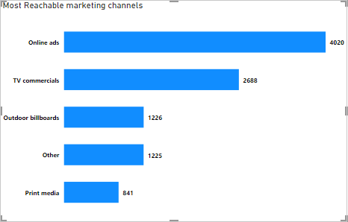
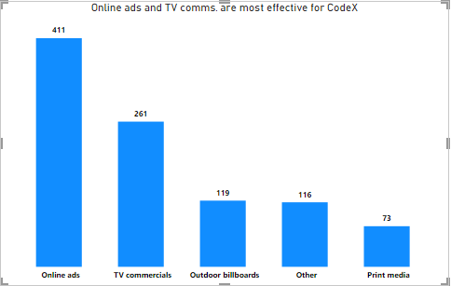
4. Marketing Channels and Brand Awareness :
Insights:
Over all awareness comes from Online ads and TV commercials.
Whereas For CodeX (68.57%) of awareness comes from Online ads and TV Commercials.

Slide 9
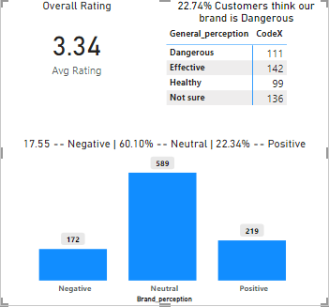
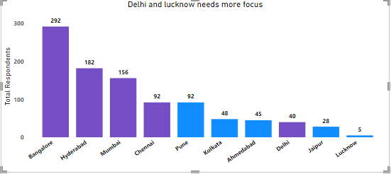
5. Brand Penetration:
Insights:
Average Taste experience is 3.34/5 which is second best in the market just after cola coka with (3.35)
providing that respondents have tested it before (Tried before = “Yes” and Heard before = “Yes”)
because respondents are more likely to test it if they have already heard of brand.
22.47% of respondents thinks that our brand is dangerous for health that needs to be changed.
60.10% respondents has a brand perception as Neutral/Average brand

Slide 10
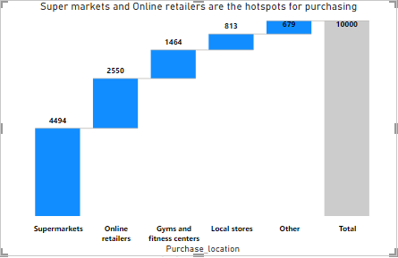
6. Purchase Behavior:
Insights:
70.44% of the sales are coming from Supermarkets and Inline retailers.
Suggestions:
To boost the sales further more in,
For Supermarkets product placement can be very beneficial like stacking our product with or near by already trusted products
For Gyms/fitness centers specific product can be placed like product with higher vitamins.

Slide 11
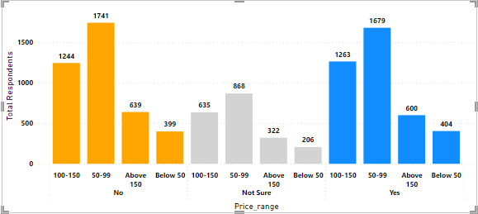
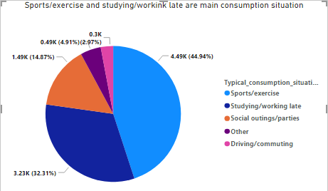
6. Purchase Behavior Cont.
Insights:
Sports/exercise and studying/working late are the top reasons for consumption.
As far as factors affecting purchase is considered most customers are from (50-99) price range and for the limited addition slightly more customers are not interested following closely those who are interested in it.
Suggestion:
In spit of customers not interested in limited addition those who are interested are almost same so for that reason limited editions should be introduced. If its in 50-99 range than it will definately boost the business.

Slide 12
7. Product Development (brand/Taste/availability):
Branding:
As shown previous brand penetration sild overall perception (brand name/logo/design) more innovative and attractive design is needed to move the average perception from neutral to positive.
Taste:
As of now the taste of our brand is more than average than other companies. Still new flavors, more natural ingredients and reduction in sugar content by replacing it with natural alternatives like;
1. Stevia
2. Coconut palm sugar
3. Deionized grape juice concentrate.
might help to overcome any issues regarding taste and health.
Availability:
Availability is an issue as shown in brand penetration sild even in Tier -1 cities like Delhi and Lucknow as Tier -2 needs much more attention to reach more and more customers.
Delhi has most number of daily consumption frequency so availability issue in Delhi is simply unacceptable.

Slide 13
Secondary Insights:
Q1. What immediate improvements can we bring to the product?
‌In every city customers think that brand is dangerous, this can be change somewhat by following caffeine propionate to the recommended guideline by FSSAI and including more natural ingredients can also be helpful.
‌Non availability of products should be reduced at least in tier-1 cities.
‌Overall rating of the brand is just neutral, that can be changed by focusing more into improvement desired section like ( reducing sugar content, adding more natural ingredients etc.)
‌Almost 47% of the audience is either not getting the product available Or thinks it's dangerous to consume it which can be reduced by combining 1st point.
‌As per survey reduction in sugar content is necessary, that can be done by replacing sugar by natural alternatives like stevia, coconut palm sugar great for diabetic people can be used in energy/health (Issue:- Greater cost than others), Deionized grape juice concentrate (Deionized may sound quite chemically but it is just that color and flavors are removed from the extracted sugar so the sweetener could be used more widely. (Source - mydrinkbeverages.com)

Slide 14
Secondary Insights:
Q2. What should be the ideal price of our product?
Most people among respondents are buying in range of 50-99 so that should be the pricing range.
Q3. What kind of marketing campaigns, offers, and discounts we can run?
OFFERS: On every weekends offers like BUY 2 GET 1 can be offered and in summer festival / weekends
BUY 1 GET 1 can be offered (ONLY FOR MORE THAN 500ML / 1L QTY).
Creating Hashtags: Create hashtags on various occasions like;
Monday Hashtags : #Motivation- Monday.
‌Holiday Hashtags: # Spooky Halloween etc
‌For new releasing products like #NewRelease [weekday]
‌Other hashtags like #thirstythursday, #FreshnessFriday, #FreeebieFridayetc can be used.
DISCOUNTS: The most advisable period throughout the year to make the unique impact for new joining customer is Halloween. Launching a new spooky drink during that period can boost overall sales and can gain trust towards company.

Slide 15
Secondary Insights:
Q4. Who can be a brand ambassador, and why?
Choice 1: MSD because they need more energy than others and their fanbase is huge and as of our data ~45% consumption is due to sports/ Exercise and a huge fan base across the nation of 44.6M
on Instagram + ~27 M on Facebook.
Choice 2: Ranveer Singh because he is the most energetic of all and has a fanbase of 43.7M on Instagram.

Slide 16
Secondary Insights:
Q5. Who should be our target audience, and why?
From the responses it's clear that most young persons (19-30) are buying out product (55.20%) and are easily accessible for marketing through various social media.

